Slide 1
PRODUCT 1 AND PRODUCT 2 HISTORICAL DATA
Made by Chandira Irina
Notes:
Hello. Let me first introduce myself. My name is Irina. I am the candidate for Blank Space DA track scholarship. Here I will present my findings as well as my suggestion based on historical data of product 1 and product 2 .

Slide 2
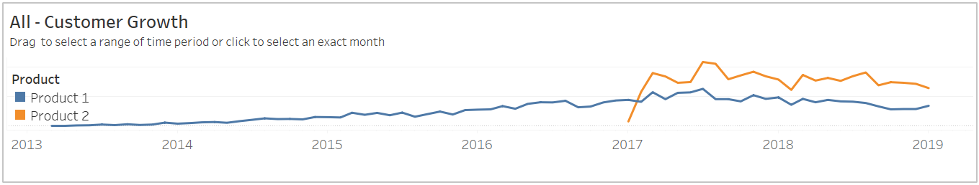
OVERVIEW
Product 2 has more customers compared to Product 1
Notes:
First, I would like to start with looking at the performance of the two products. Here, the graph shows that product 2 has just been introduced into the market in January 2017. It seems to be accepted by the market pretty fast to the point that the customer of product 2 surpasses product 1’s, which has been around at least from Q2 2013. This could mean that product 2 is potential to be developed even further so as to acquire more market share. Now the question is, how does the good performance of this product actually affects the cash flow of our company? Like, ok, it is widely accepted, we get more customers, but is it actually profitable?

Slide 3
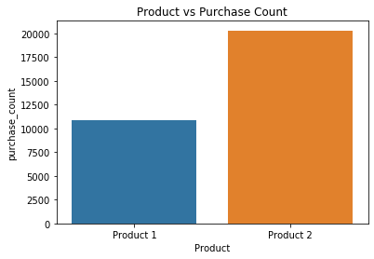
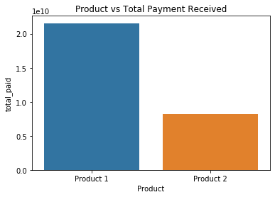
DEEPER LOOK
Even though product 2 has more customers and purchase count, the total payment received is far below product 1.
Notes:
Since each customer may make more than one purchase, we could look deeper into the data to see how the purchase count for both products during the period after Product 2 is introduced. Proportional to the higher number of customer of Product 2, the purchase count for product 2 also almost 2 times higher than product 1. However, there is an interesting finding that the total payment for product 2 seems to be much lower, even more than half of the product 1. This must be caused by the subscription fee for product 1 is much higher than product 2. Therefore, I think it becomes necessary to maybe look deeper into the option to increase the subscription fee for Product 2 in order to increase the profit for company. However, if it is not possible at the moment, we could also look into the option to put more focus on growing Product 1.

Slide 4
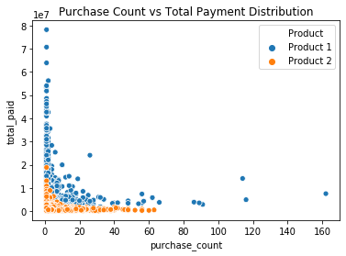
Higher total payment for less purchase count seems to be dominated by Product 1, while total payment for Product 2 is concentrated in the lower region.

Slide 5
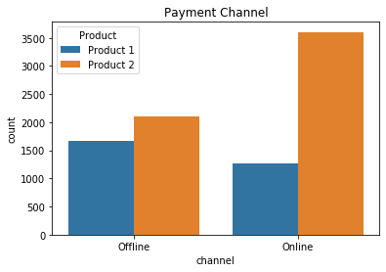
OTHER FINDINGS
Product 2 purchased more via online channel compared to offline channel, while product 1 is the other way around.
Notes:
Looking further into the payment channel, it was found that product 2 has been purchased more via online channel compared to offline channel, while product 1 is the other way around. This is a great insight that we could look deeper on what caused this. In this digital age, I believe that people must lean more into online payment. I think we could look into why more people choose to use offline channel. Is there any problem with the online payment channel that could also be the reason that Product 1 has less customer.

Slide 6
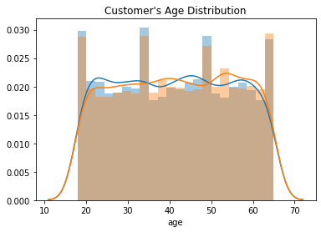
The target market distributed quite evenly throughout the age range 18-65.
Notes:
However, the target market actually distributed quite evenly throughout the age range of 18-65, hence, it is important to keep the offline channel maintained well for the older customers who might still use to with the offline payment channel. This applies for both product 1 and product 2.

Slide 7
Possible Action(s) to Take
Put more focus on marketing for Product 1
Increase the fee for Product 2 subscription
Look further into the online method to purchase Product 1
Keep on maintaining the easeness of using offline method
Notes:
In conclusion, after looking at the historical data, there are some possible actions to be considered to be taken.
First, we could put more focus on marketing for Product 1, considering Product 1 brings more cash flow into the company with less purchase compared to product 2.
Second, we could also increase fee for Product 2 subscription to increase the cash flow of the company and will result in more profit for the company. However, we should also consider the possibility of customer churn if we take this action.
Third, we could check if there is any problem with online method to purchase Product 1 since there are more offline purchase made for Product 1 compared to Product 2, which is more dominated by online purchase. We could look further if this contributes to Product 1’s lower growth in terms of number of customers as well as purchase count.
However, fourth, we need to also maintain the use of offline method since offline purchase still contribute a lot to the growth and that the distribution of our customer’s age are pretty much even from 18-65. Older people might be used to using offline method hence we need to facilitate them too.

